Slide 1
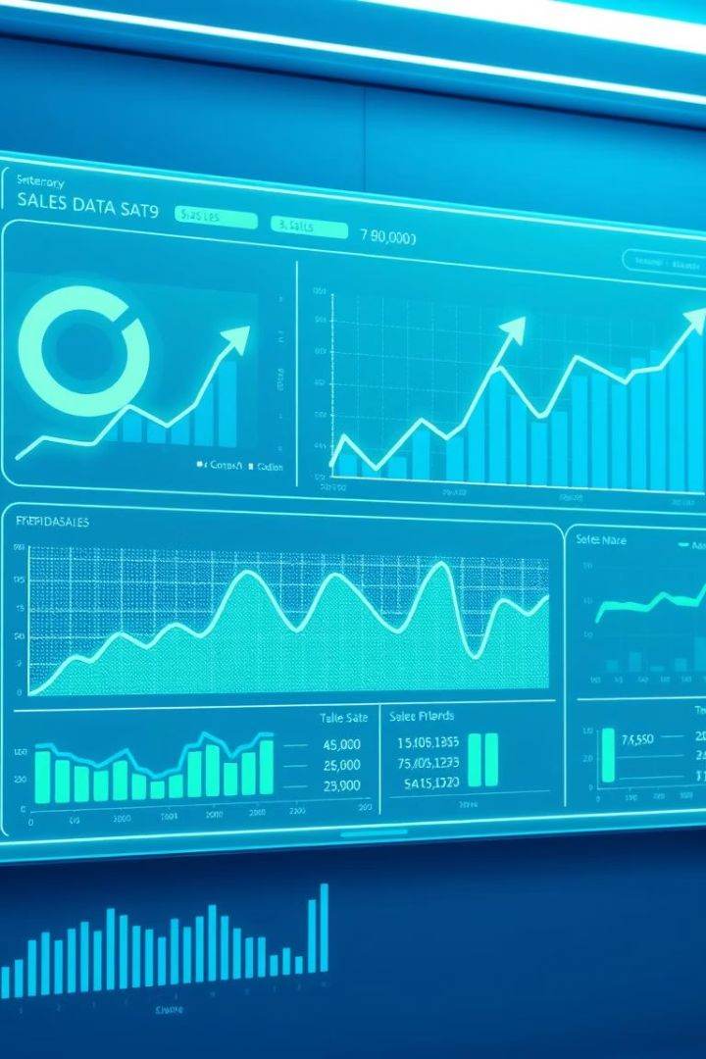
Introducing Sales Trend Analyzer
Discover the Sales Trend Analyzer. It delivers data-driven insights that fuel revenue growth. Predict, analyze, and optimize sales performance. Empower your sales teams with actionable intelligence.
Name:- Jitender Kumar Giri
UID:-22BCA1176

Slide 2

Key Features and Benefits
Predictive analytics
Forecast future sales trends with 95% accuracy.
Real-time dashboards
Monitor key performance metrics instantly.
Competitor analysis
Identify market opportunities, potentially worth $1M+.
Customizable reports
Generate insights tailored to your specific needs.

Slide 3





How Sales Trend Analyzer Works
Data ingestion
Advanced algorithms
Trend identification
Connects seamlessly to your CRM, ERP, and marketing platforms.
Utilizes machine learning to identify key patterns.
Spots emerging trends and anomalies in real-time.
Actionable recommendations
Provides prescriptive insights to drive sales growth.

Slide 4




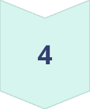
Identifying Seasonal Trends
Data Analysis
Analyzes historical data to predict demand spikes.
Inventory Optimization
Optimizes inventory levels.
Staffing Optimization
Optimizes staffing allocations.
Sales increase
Achieve a 15% sales increase during peak season.

Slide 5
Pinpointing Underperforming Products
Root cause
Campaign Recommendations
Product Updates
Identifies root causes like market saturation and increased competition.
Recommends Product Updates
Recommends targeted marketing campaigns.
Software company with declining product line experiences a 10% increase in product sales within 3 months.

Slide 6
Sales Trend Analyzer vs. Traditional Methods
Manual spreadsheets
1
Time-consuming and prone to errors.
Basic reporting tools
2
Limited insights and lack predictive power.
Our Solution
3
Automated, accurate, and actionable.
Average ROI: 300% within the first year.

Slide 7




Implementation and Onboarding
Seamless integration
Dedicated support
1
Integrates with existing systems.
Receive training and assistance.
2
Comprehensive onboarding
4
Quick Setup
Data migration, configuration, and user training included.
3
Setup in 2-4 weeks.

Slide 8

Key Takeaways
Competitive edge
Data-driven decisions
Sales Trend Analyzer: Your competitive edge
Data-driven decisions for sustainable growth
Optimize performance
Drive revenue, optimize performance
Contact us for a demo and customized solution.

